Slide 1

Rajkiya engineering college, azamgarh
Topic – Web Development
Submitted By- Submitted To-
Sonal Kumari Miss. Sonam Arya Mam
I.T. 2nd yr Mrs.Puja Mam

Slide 2
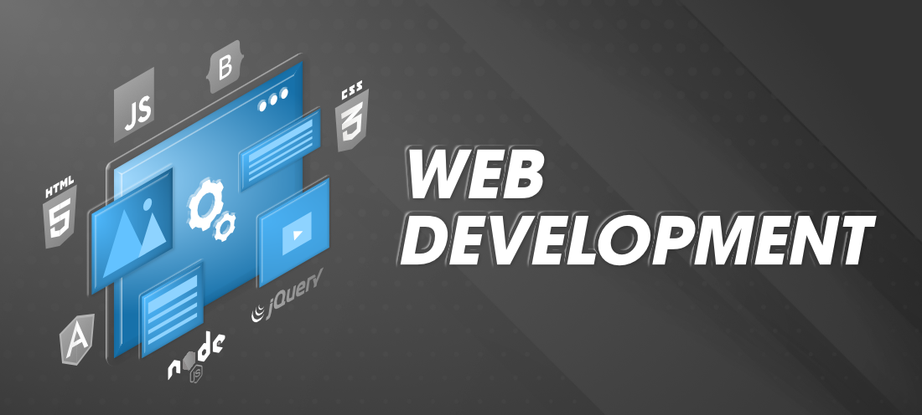

Slide 3
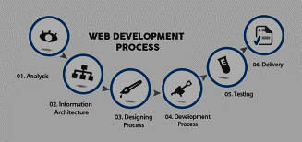
DATA flow diagram

Slide 4
Web development
Web development refers to the building, creating, and maintaining of websites.
It includes aspects such as web design, web publishing, web programming, and database management.
It is the creation of an application that works over the internet i.e. websites.

Slide 5


Slide 6
Web Designer Vs. Web Developer
A web designer
Design the layouts, fonts, color, images, and overall branding.
Rarely does the development of a website!
A Right- braided (Creative) person.
A Web Developer
Develops the website and hosts on a web server.
Has Web Development Skills: HTML, CSS, JavaScript, React.js, Node.js
A Left-braided (Logical) person

Slide 7
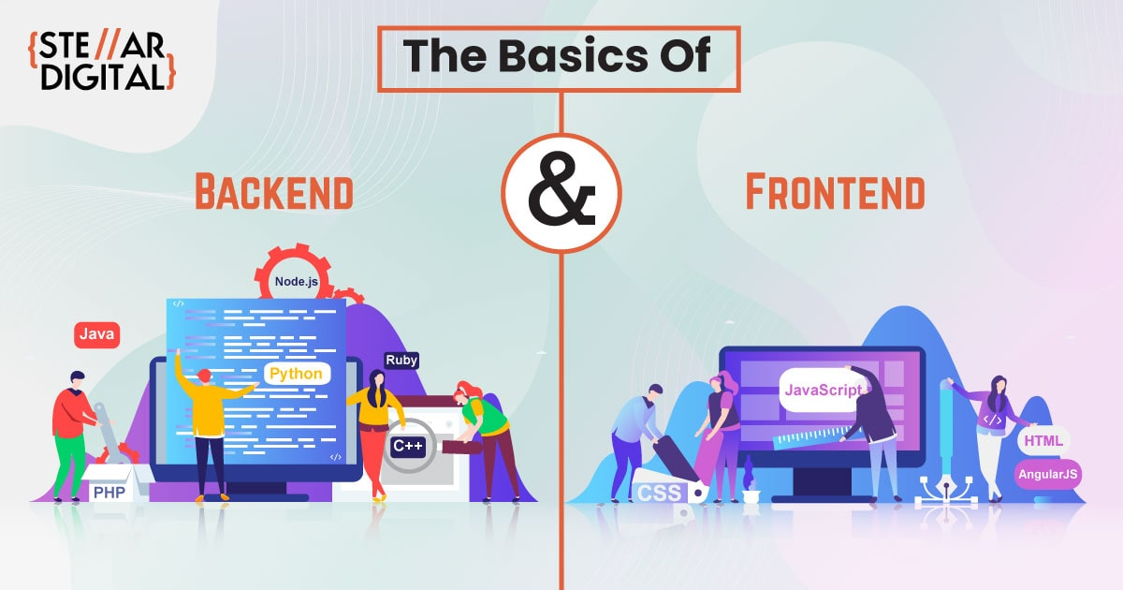

Slide 8
Front end and back end web development
Front End Web Development
Defines components on the page with HTML.
Make them look pleasing with CSS.
Enable interactivity with use of frameworks.
Back End Web Development
Deals with Servers, Send the HTML + CSS + JavaScript to web browser.
Generates pages by programming in Java, JavaScript, PHP, Perl, Python, Ruby.
Aim to achieve fast response times to end users.

Slide 9
html,css, and javascript – an overview
HTML
Hypertext Markup Language
Structure of Page
CSS
Cascading Style Sheets
Presentation/Styling
JavaScript
Interactivity with User
Dynamic Updates in a Web Page

Slide 10
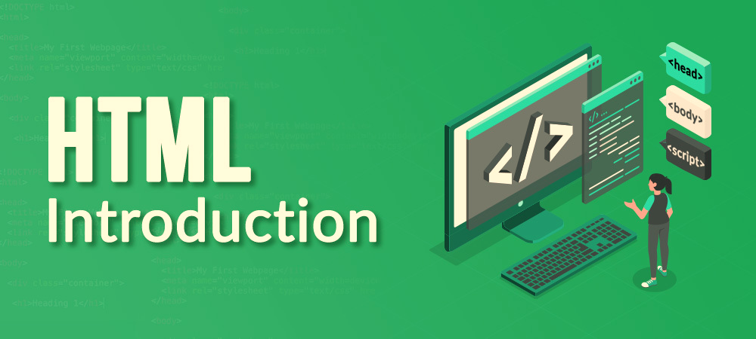

Slide 11
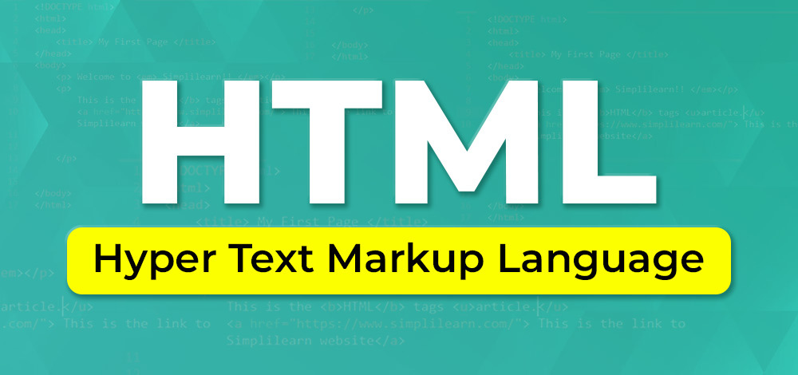

Slide 12
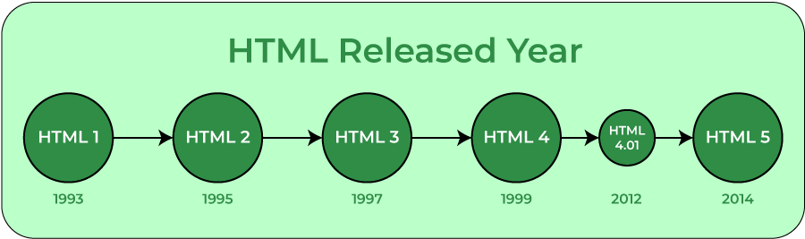

Slide 13
Html Editors
HTML text editors are used to create and modify web pages. HTML codes can be written in any text editors including the notepad. One just needs to write HTML in any text editor and save the file with an extension “.html” or “.htm”.
Some of the popular HTML text editors are given below:
Notepad
Notepad++
Sublime Text 3
Atom
Visual Studio Code

Slide 14
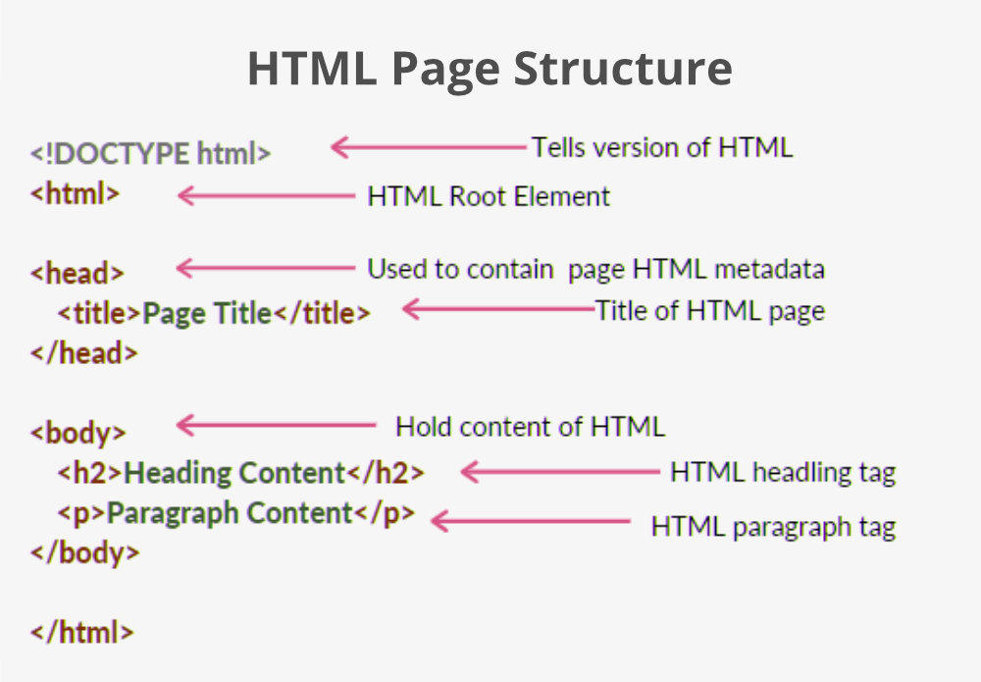

Slide 15
Features of HTML:
It is easy to learn and easy to use.
It is platform-independent.
Images, videos, and audio can be added to a web page.
Hypertext can be added to the text.
It is a markup language.
An HTML document can be created using any text editor. Save the text file using .html or .htm.
Once saved as an HTML document, the file can be opened as a webpage in the browser.

Slide 16
Advantages:
HTML is used to build websites.
It is supported by all browsers.
It can be integrated with other languages like CSS, JavaScript, etc.

Slide 17
Disadvantages:
HTML can only create static web pages. For dynamic web pages, other languages have to be used.
A large amount of code has to be written to create a simple web page.
The security feature is not good.

Slide 18
A simple html5 page
<!DOCTYPEhtml>
<html>
<head>
<title>This is My First Website</title>
</head>
<body>
<p>Welcome to HTML5, CSS3 andJavaScript!</p>
</body>
</html>

Slide 19
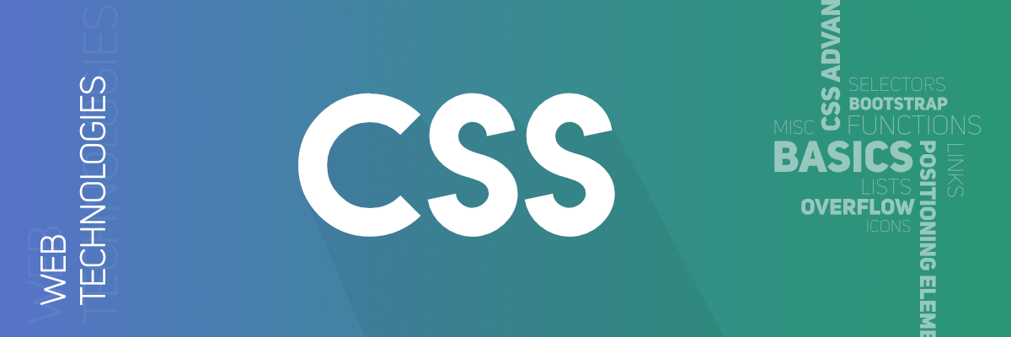

Slide 20
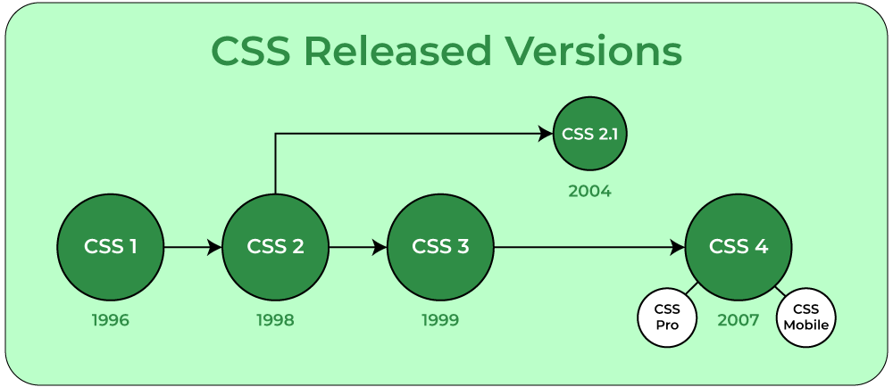

Slide 21
css
CSS (Cascading Style Sheets)is used to apply styles to web pages.
Cascading Style Sheets are fondly referred to as CSS.
It is used to make web pages presentable.
It allows you to apply styles on web pages.
More importantly, it enables you to do this independently of the HTML that makes up each web page.

Slide 22
There are three types of CSS which are given below:
Inline: Inline CSS contains the CSS property in the body section attached with the element known as inline CSS.
Internal or Embedded: The CSS ruleset should be within the HTML file in the head section i.e the CSS is embedded within the HTML file.
External: External CSS contains a separate CSS file that contains only style property with the help of tag attributes.

Slide 23
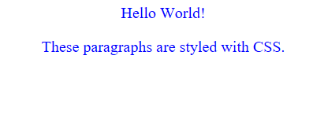
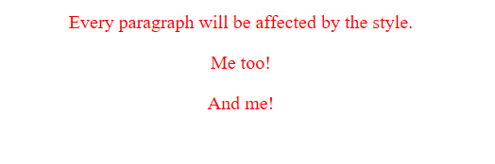
EXAMPLES

Slide 24


